Slide 1
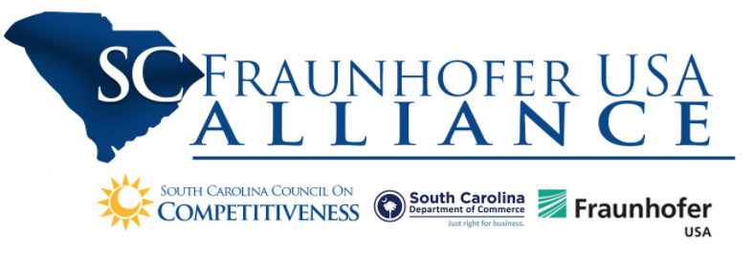



Proactive and Automated Control for BMW

Slide 2
Outline
Team Introduction
Overview of Project
Approach
UofSC Tasks and Deliverables
Fraunhofer Tasks and Deliverables
Phase 2 and Next Steps

Slide 3
Project Team
BMW: Josh Abel, Ken Kennedy, Allen Godsey, Shawn Mangiafico
UofSC: Abdel Bayoumi, Rhea Matthews, Evan Meaney, Andre Calderon, Rhiannon Bullard, Amit Sheth, Pankesh Patel, Forest Agostinelli, RJ Gleaton, Ashik Kumar
Fraunhofer: Jeno Szep, Brook Stacy, Michael Miller, Prahlad Menon

Slide 4
Project Overview
Challenge
Solution
Deliverables
BMW assembly processes integrate thousands of parts, sourced from a wide variety of suppliers, located around the world
If these parts fail to arrive on time, costly delays and work stoppages follow
Requires monitoring that is done manually by highly experienced supply chain professionals
Tedious and expensive
BMW seeks improved data-driven algorithms, systems and processes
Successful solutions will capture, analyze and exploit datasets to enable optimized and proactive materials control, optimize specialized human expertise, and reduce line stoppages due to missing parts
AI material planner assistant and model for forecasting part shortages
This solution could be applied to other supply chain needs and could be scalable

Slide 5
Statement of Work
Phase 1: Data Collection and Development
Data collection and analysis
Develop models representing a wide range of data and interrelationships
Identify subset of “easy to plan” parts, automate handling of these parts, suggest actions to take given a part’s status
Evaluate path to full automation of low-risk parts
Phase 2: Proactive and Automated Reporting Integration
Validate and enhance developed models and AI material planner
Develop dashboards and reporting

Slide 6

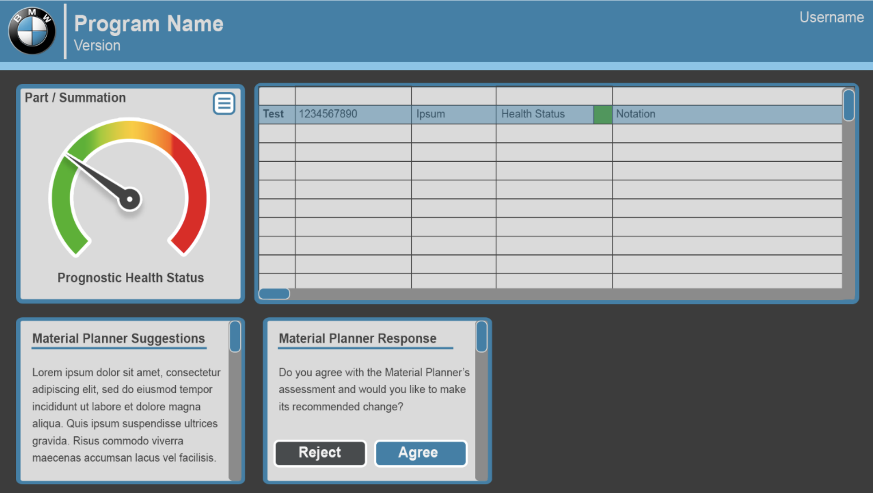





Conceptual design
Parts DB
Fetch and Retrieve Part Info
Dashboard
A
B
H
Get Recommendation
Fetch Part Info
Material Planner (Table 1)
E
Make Recommendation
C
D
G
Supplier (Table 2)
Material Config. (Table 3)
Run Forecast Model
Fetch Forecast Model
Parts
Forecast
Model
I
J
F
Fetch Rulesets
Recommendation
Decision & Reason
Material Trans. (Table 4)
AI Material Planner Assistant
Recommendations (Table 6)
Exception (Table 5)
Rule sets and Business logic

Slide 7
Timeline
Kickoff
Midpoint Review
Month 1 | Month 2 | Month 3 | Month 4 | Month 5 | Month 6 | Month 7 | Month 8 | Month 9 | Month 10 | Month 11 | Month 12
UofSC 1 |  |  |  |  |  | UofSC 4
 |  | UofSC 2
 |  |  | UofSC 3
FhUSA 1 |  |  |  |  |  | FhUSA 4
 |  | FhUSA 2 |  |  |  |  |  |  | FhUSA 5
 |  |  |  | FhUSA 3
BMW 1 |  |  |  |  |  | BMW 4
 |  | BMW 2 |  |  |  |  |  |  | BMW 5
 |  |  |  | BMW 3 |  | BMW 6
 |  |  |  |  |  |  |  |  | BMW 7

Slide 8
Tasks and Deliverables – Phase 1
Task # | Description | Deliverable | Time Range
BMW 1 | Gather and provide the partners with historical BMW data | Historical BMW data delivered to partners | Months 0-1
UofSC 1 | Exploration of historical BMW and extraneous data for forecasting part deliveries | Document: Key figures from historical data, rich/poor areas, supplier ranking | Months 0-2
FhUSA 1 | Stakeholder interviews to identify how material planners approach problems | Prototype ER model, Presentation to stake holders | Months 0-2
UofSC 2 | Data formatting and interrogation to identify relationships in data and capabilities of forecasting model | Key capabilities for part-forecasting model and prepared data for model creation | Months 2-5
BMW 2 | Assist in AI material planner development | Active support and reviews | Months 2-5
FhUSA 2 | Create AI Material Planner Assistant Prototype | Software: AI model material planner prototype. Workshops with partners to prepare integration | Months 2-5
UofSC 3 | Develop parts forecasting model | Software: AI model prototyping forecasting capabilities | Months 4-6
FhUSA 3 | AI assistant model validation | Tutorial on AI model, signals and patterns. Updated AI Model | Months 5-6
BMW 3 | Perform model validation and testing | Active support and reviews | Months 5-6
Midterm Review – Demonstration of AI parts forecasting model and AI planning assistant prototypes

Slide 9
UofSC Task 1: Data Exploration
Subtasks
Activities and Milestones
Understand headers
Get information on quality, ordering times, transportation, etc.
Identify poor areas/gaps in data
Make timeline of orders
Define states (early, tardy, too late)
Calculate numbers for tangible and intangible criteria ​
Create supplier ranking
Integrate findings into deliverable document ​
Reviewed initial datasets (reports containing information on stock, suppliers, demand, material, demand, etc.)
Reviewed user documentation
Conducted interviews with Material Planners
Developed initial Parts Ranking Algorithm
Created Dashboard Mockup
Developed initial ER Diagram
Deliverable: key figures from historical data, rich/poor areas, supplier ranking

Slide 10

0 %
100 %
Material Planner
Plant
Supplier
Health
Status
Dashboard
Material
Planner
has
1..*
Supplier
(Vendor)
recommend
Responsible
supply
Supply
use
Output
1..*
Material
Planning
has
Material
(Part)
input
Material Inventory
input
Material Trans.
use
Material Config.
generate
Exception
Exception

Slide 11
Material Planner
MRPCn (PK)
Planner Name
Vendor ID (FK)
Material Transaction
Material ID (FK)
Plant ID (FK)
MRPCn (FK)
Vendor ID (FK)
Shipment ID (FK)
Demand Date (Date, TimeStamp)
MRP Element (Text, category)
Change Qty (number, Qty)
Total Qty (number, Qty)
Supply
Shipment ID (PK)
Material ID (FK)
Vendor ID (FK)
Purchase Order #
Trailer ID (number, Key)
Source of Shipment (Lat., Lng, Address)
Dest. of Shipment (Lat., Lng, Address)
ETA to Dest. (number, hrs.)
Supply TS (Date, TimeStamp)
Material Planner
KPI
Material Config.
Material ID (PK)
Material Desc
Safety Stock (number, Qty)
Planning Time Fence
Safety Time
Planning Calendar
Dashboard
Material ID (FK)
Health Status (number , 0-100 in %)
Stock DoS (number, in Days)
First Receipt DoS (number, in Days)
Exception ID (FK)
?
?
Plant
Plant ID (PK)
Plant Location
MRP Area
Supplier
Vendor ID (PK)
Vendor Name
Material ID (FK)
Exception
Exception ID (PK)
Exception Msg

Slide 12
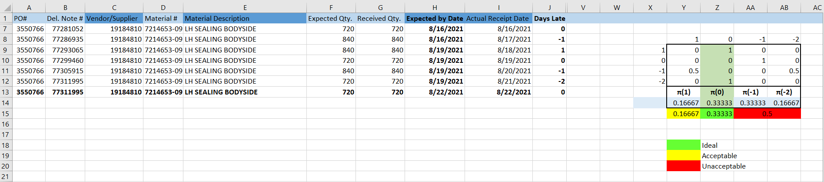
Part Ranking Algorithm
For this specific sample part (bolded fields were created randomly) the data shows there is a 16% chance this part will arrive one day early, 33% chance it will arrive on time, 33% chance it will arrive one day late, and 16% chance it will arrive two days late (50% chance of late arrival)
The more historical data there is available, the more accurate the ranking is
Suppliers will be ranked based on % chance of on time arrival

Slide 13
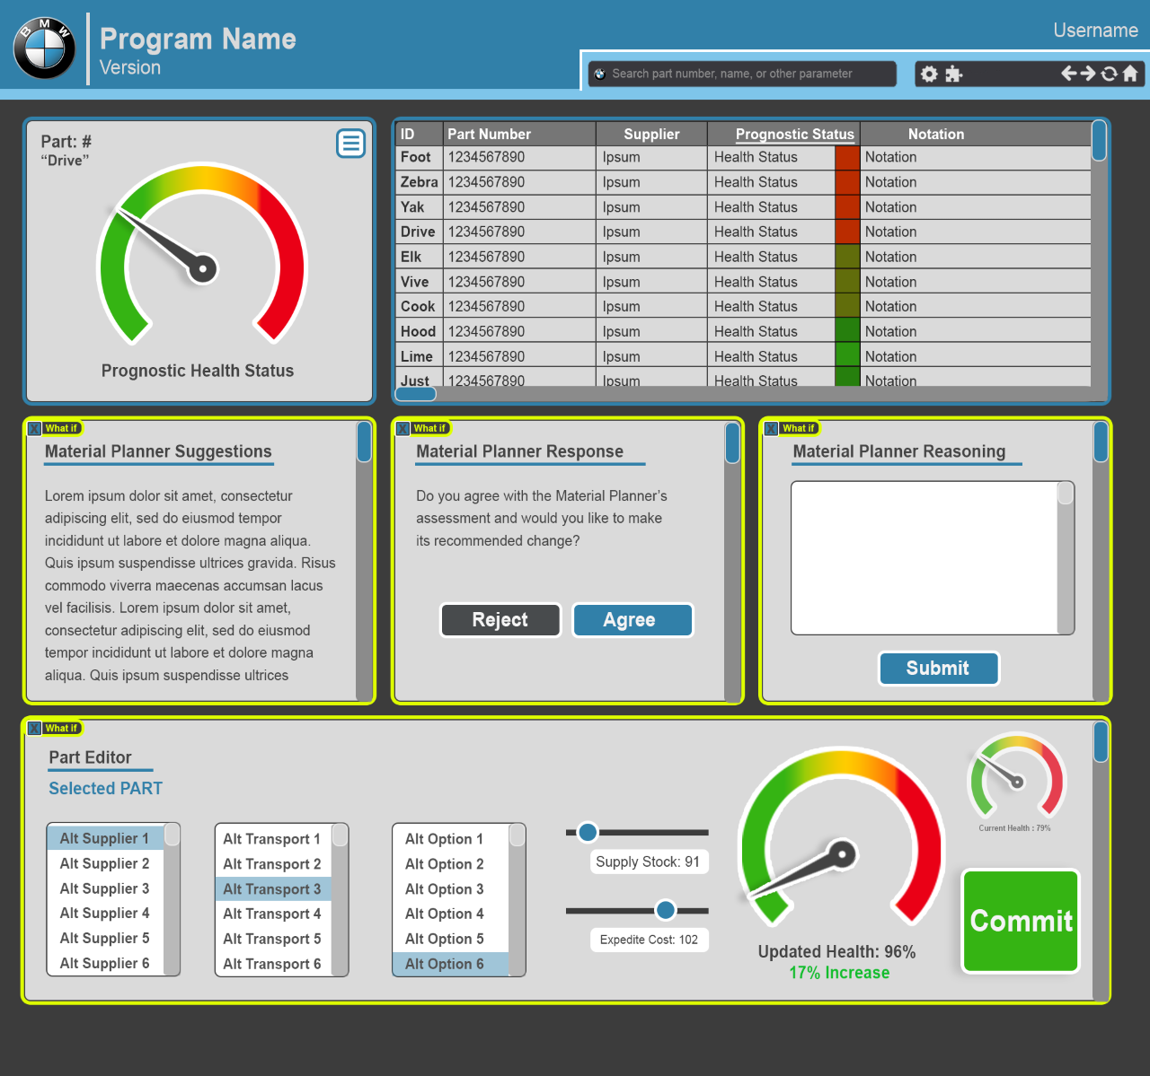
User Dashboards
One of the main objectives of the dashboards is to aid in reducing the time a planner spends looking up information, the dashboard will integrate all needed data and analysis into one location
The planner can view the status of their parts and a gauge will replace the stoplight to give a more exact representation.
The material planner suggestion will be displayed along with a box to collect the Planner’s feedback on why they accepted or rejected
The dashboard will also allow for creating “what if” scenarios based on alternative suppliers, transportation, stock, etc.

Slide 14
UofSC Tasks 2,3: Data Interrogation / Model Development
Subtasks
Activities
​
Deliverable: Key capabilities for part-forecasting model and prepared data for model creation and initial model

Slide 15
Parts Forecasting Model

Slide 16
Dashboard

Slide 17
Fraunhofer USA Task 1

Slide 18
Fraunhofer USA Task 2

Slide 19
Fraunhofer USA Task 3

Slide 20
Recommendation Engine

Slide 21
Tasks and Deliverables – Phase 2
Task # | Description | Deliverable | Time Range
UofSC 4 | Parts forecasting model validation | Software: Validated AI model | Months 7-9
FhUSA 4 | Integrate forecasting model with AI Material Planner | AI Material planner framework with integrated AI forecasting model | Months 7-9
BMW 4 | Systems of record integration |  | Months 7-9
FhUSA 5 | AI Material Planner with alerting and human readable steps created | Workshops: status updates, alerting functionalities, human readable action steps. Software: Alerting functionality, human readable action steps. Software support: support BMW with integration of system at BMW. Correction calibration of system | Months 9-12
BMW 5 | Integration of combined parts forecasting model and AI material planner |  | Months 9-12
BMW 6 | Visualization, dashboard and reporting |  | Months 7-11
BMW 7 | Feasibility study and testing | Document: Feasibility study report, final report | Months 10-12

Slide 22
UofSC Next Steps

Slide 23
Fraunhofer USA Next Steps

Slide 24
Questions

